Slide 1
BI Analysis Week 4
Shawna Tuli (Shawna.tuli@avanade.com)

Slide 2
Agenda
DATA EXPLORATION
PANDAS
FEATURE SELECTION

Slide 3
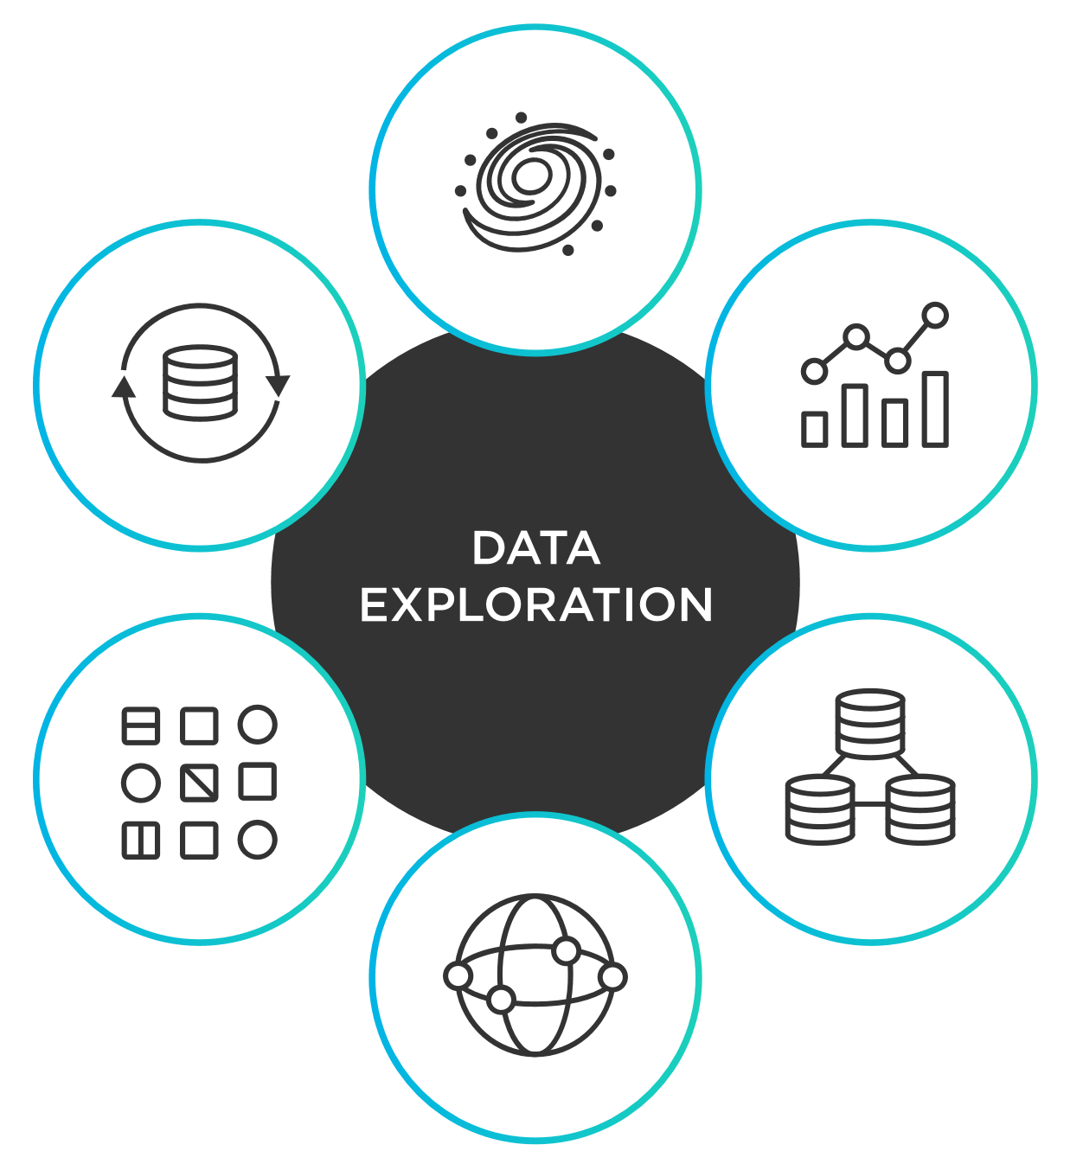
Data Exploration

Slide 4
Data Exploration
The initial review of a data set to identify patterns, characteristics, and relationships. It's the first step in data analysis and is used to prepare the data for more in-depth analysis.
What is data exploration used for?
Understanding data
Data exploration helps you understand the quality, range, and scale of your data.
Identifying outliers
Data exploration helps you identify outliers, missing values, and other anomalies.
Finding patterns
Data exploration helps you identify patterns and correlations in your data.
Forming hypotheses
Data exploration helps you form hypotheses and select the right analysis methods.
Making decisions
Data exploration helps you make informed decisions and drive strategic initiatives.

Slide 5
Data Exploration Continued
How is data exploration done?
Data exploration uses statistical techniques and data visualization tools.
Data exploration involves sifting through, cleaning, and organizing data.
Data exploration can be done manually or with automated techniques.
Why is data exploration important?
Data exploration is important because it helps you understand your data and make informed data.
Data exploration is important because it helps you identify potential fraud patterns or predict health risks.
Gemini

Slide 6

Pandas

Slide 7
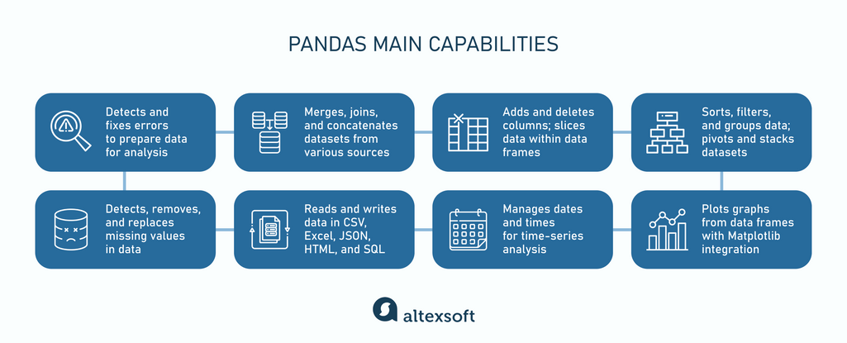

Slide 8
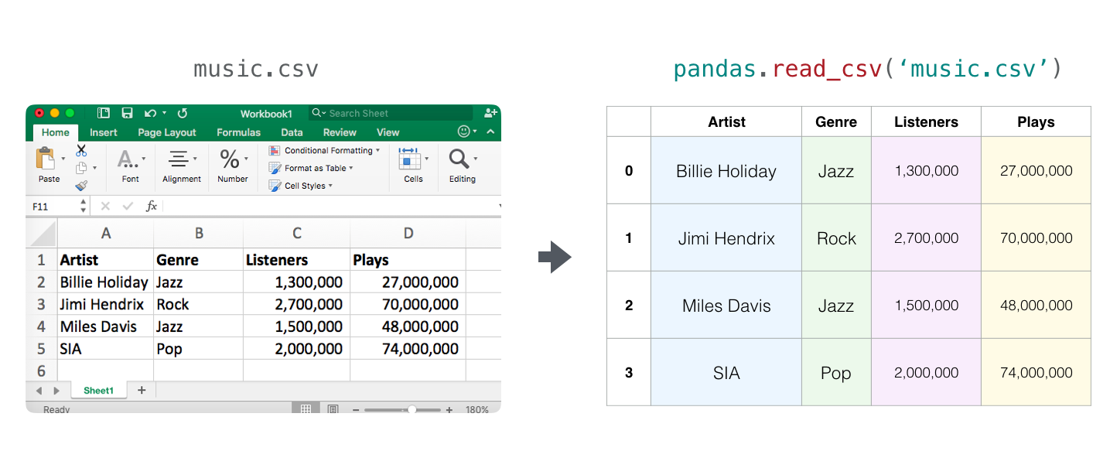
Notes:
https://docs.python.org/3/library/venv.html

Slide 9
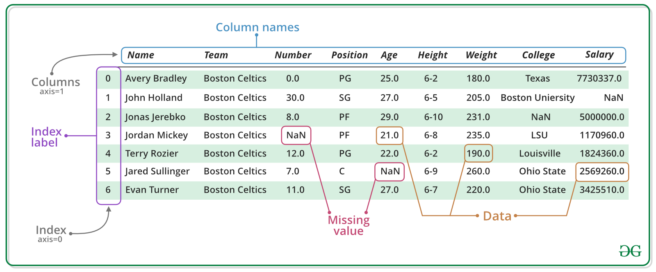

Slide 10
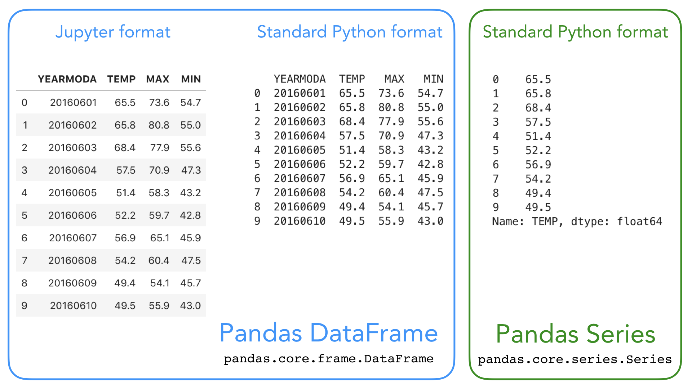

Slide 11
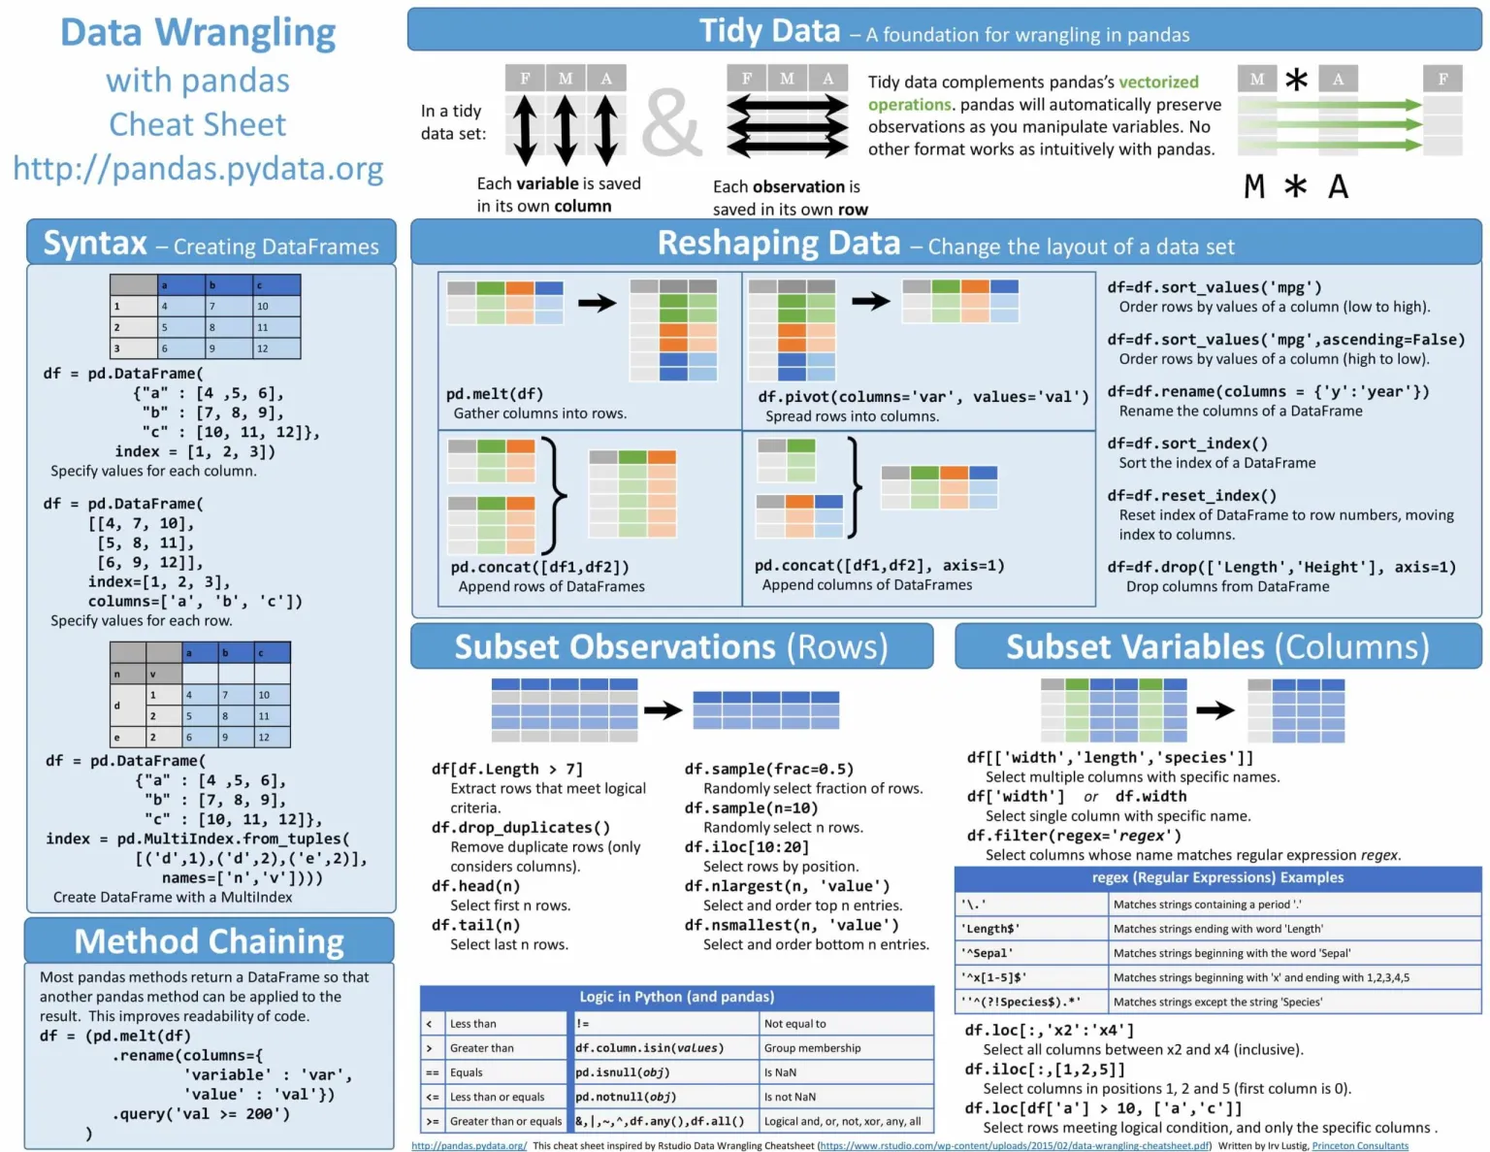

Slide 12
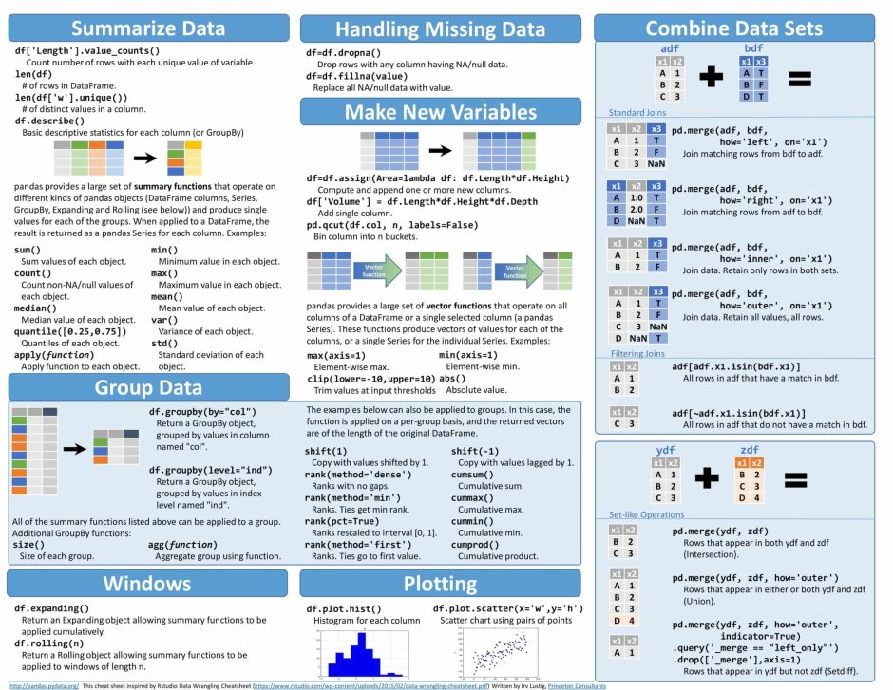

Slide 13
Feature Selection

Slide 14
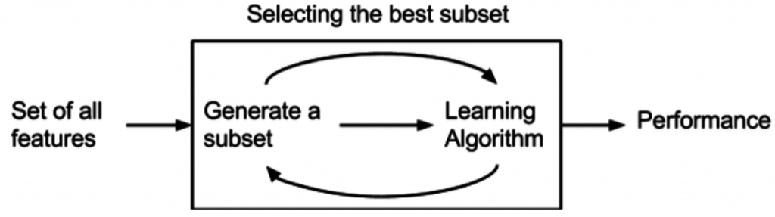

Slide 15
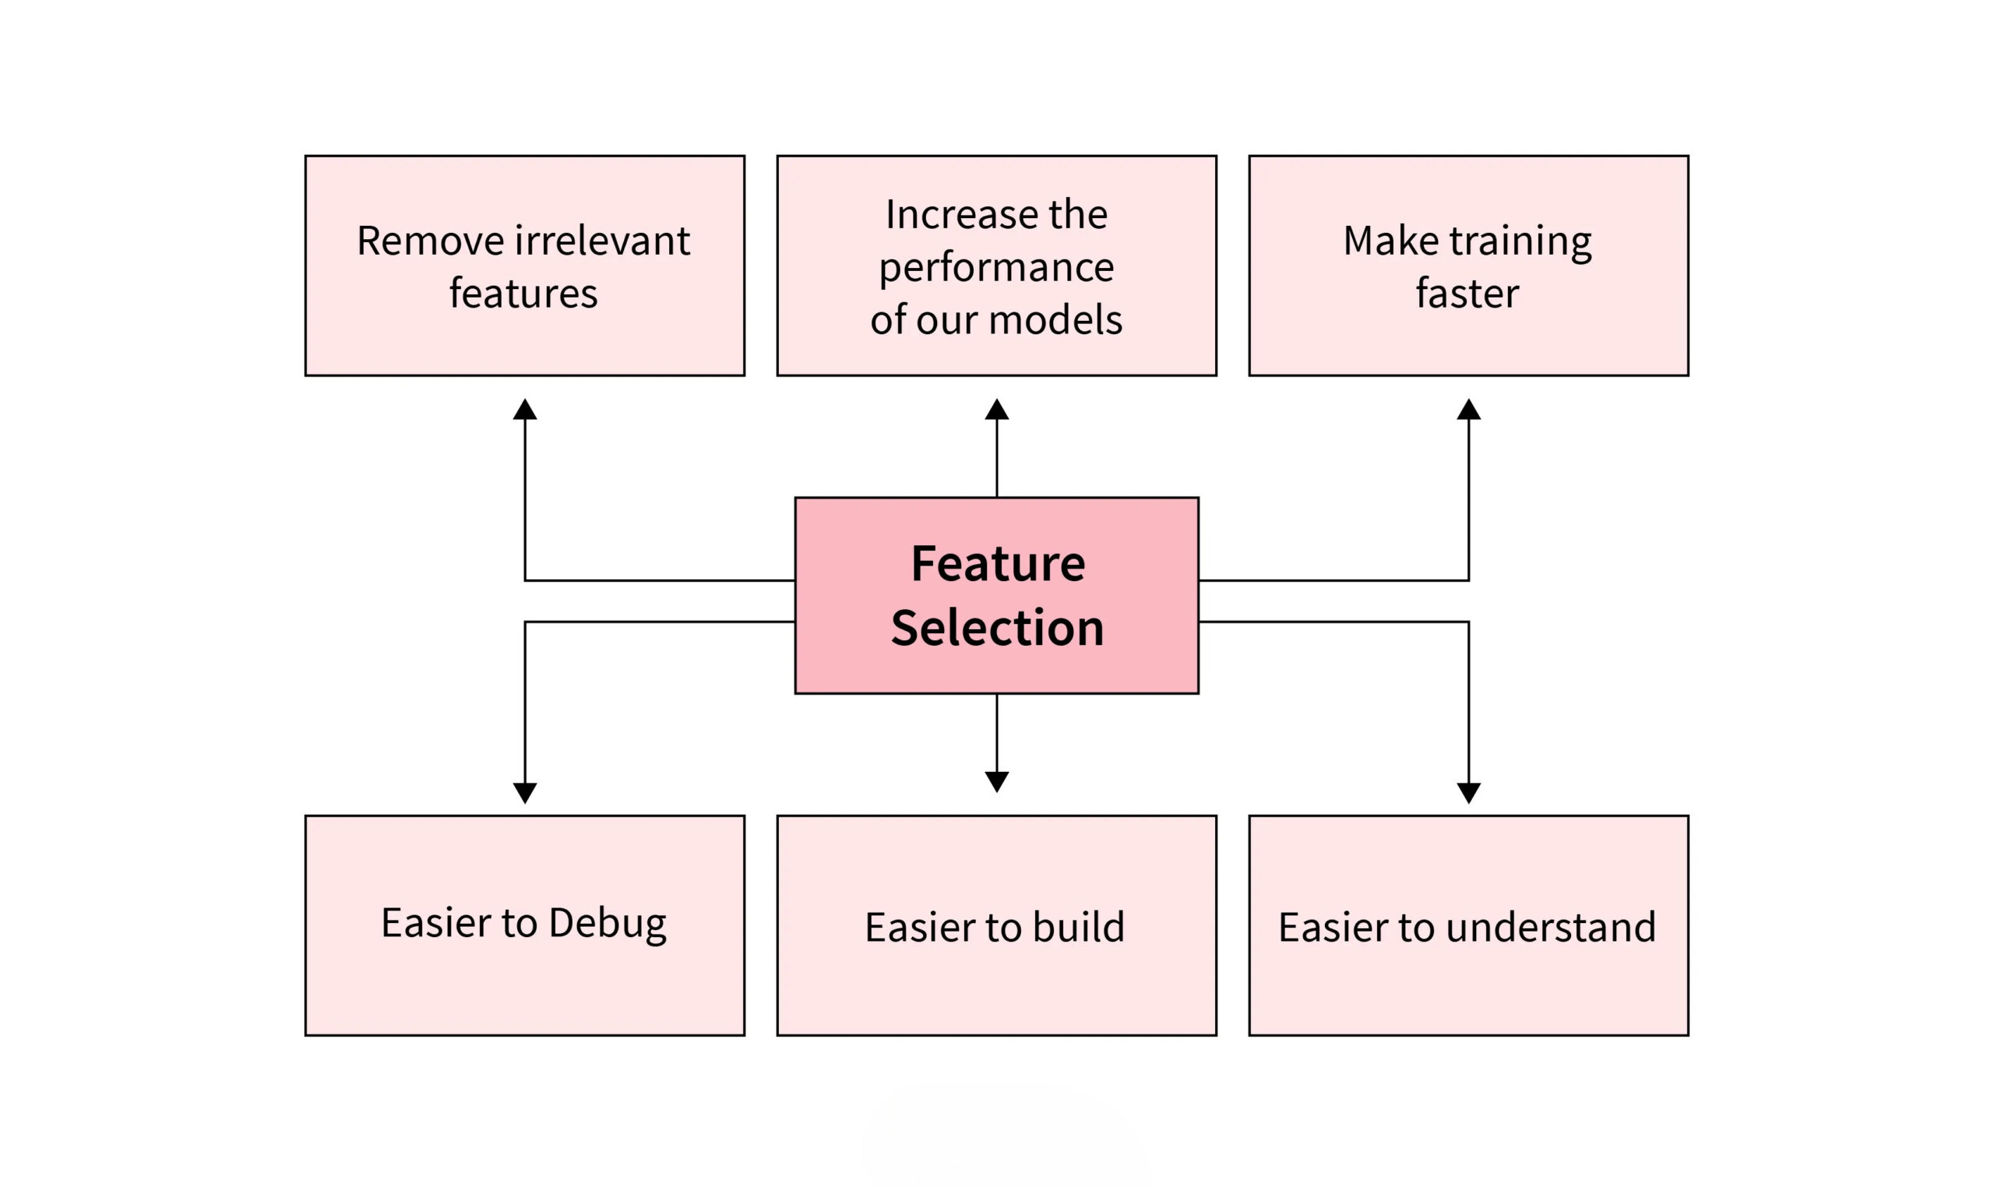

Slide 16
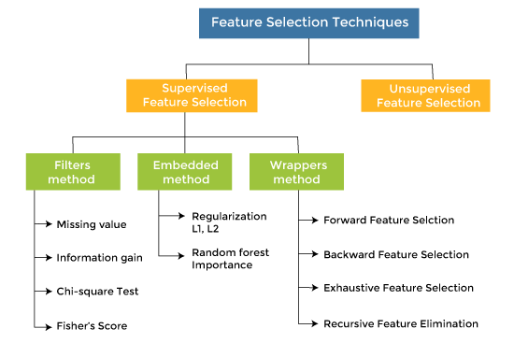

Slide 17
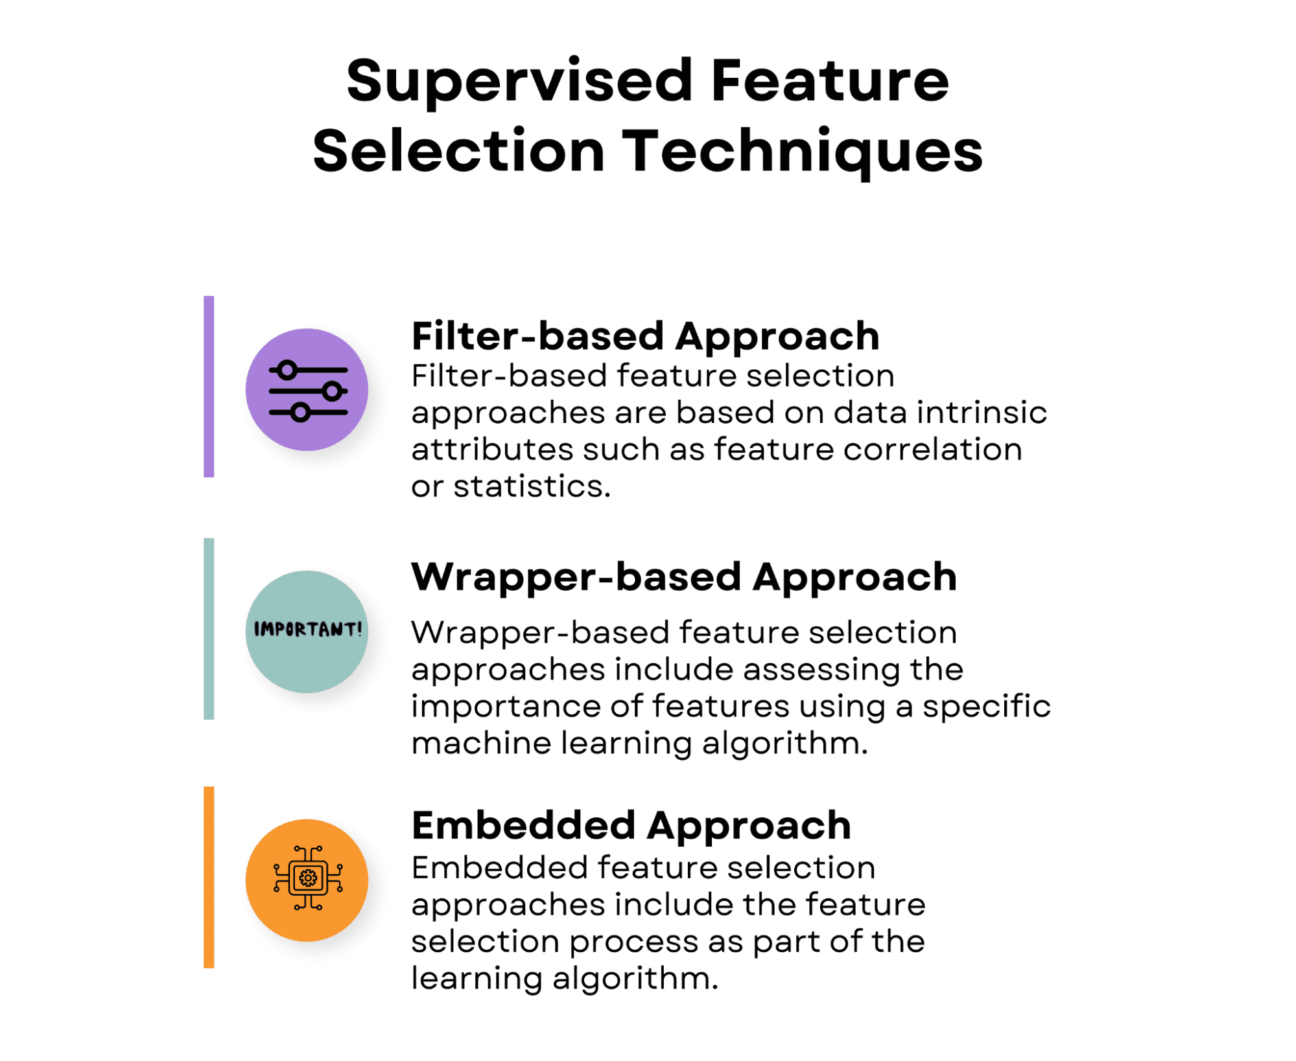

Slide 18
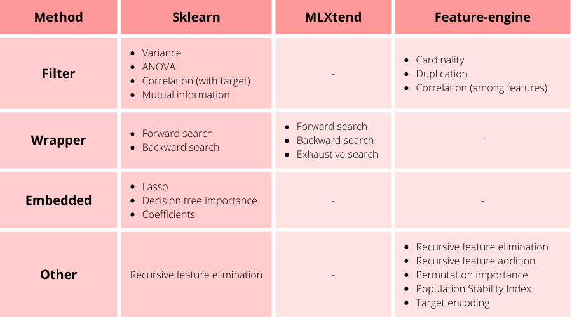

Slide 19
Timeline

Slide 20
Program
Kick-Off
Students will be meet their teams and begin planning their project.
4 Workshops
Students will attend guided workshops covering key tools used in data science projects.
Help Sessions
Data@UCI will provide mini help sessions following the end each workshop.
Final Presentations
Groups will have the opportunity to present their projects and win prizes.

Slide 21
Week | Timeline
Week 1 (1/6-1/12) | Regular Event: Info Session for Mentees
Week 2 (1/13 - 1/19) | Regular Event : Project Kick-Off
Week 3 (1/20 - 1/26) | Thursday - Workshop 1: Tour of Notebooks/Environments/IDEs + Help Session
Week 4 (1/27-2/2) | Thursday - Workshop 2: Data Exploration (Pandas & Feature Selection) + Help Session
Week 5 (2/3 - 2/9) | Thursday - Workshop 3: Machine Learning (Scikit-Learn & Model Evaluation) + Help Session
Week 6 (2/10 - 2/16) | Thursday - Collaboration with Design@UCI (tentative + midterms)
Week 7 (2/17 - 2/21) | Thursday - Workshop 4: Data Visualization (Power BI or similar) + Help Session
Week 8 (2/24 - 3/1) | Thursday - Final Winter Project Help Session
Week 9 (3/3 - 3/9) | Thursday - Final Presentations

Slide 22
Deliverables

Slide 23
Week | Deliverable
Week 1 (1/6-1/12) | Commitment
Week 2 (1/13 - 1/19) | Meeting Series
Week 3 (1/20 - 1/26) | Jupyter Notebooks
Week 4 (1/27-2/2) | Exploratory Data Analyses
Week 5 (2/3 - 2/9) | Machine Learning
Week 6 (2/10 - 2/16) | Design
Week 7 (2/17 - 2/21) | Data Visualization
Week 8 (2/24 - 3/1) | Presentation
Week 9 (3/3 - 3/9) | Final Presentation

Slide 24
Thank you!

